Slide 1
Automated PCB Inspection
Garrett Bowman
Dr. Navid Asadi
Patrick Craig

Slide 2
Why?
Hardware security is often neglected due to manpower etc
This has caused issues in the past due to importing chips
A neural network can be more accurate at detecting tampering than humans

Slide 3
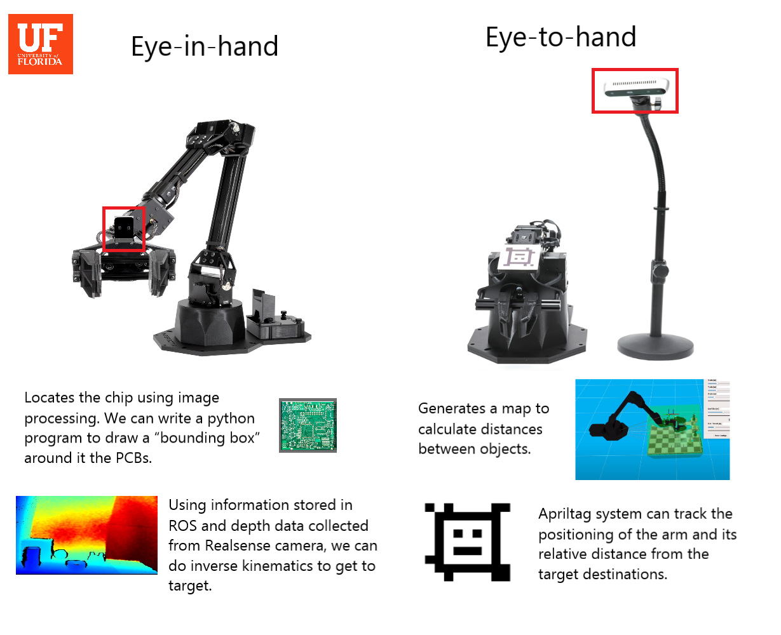
What we found
Because VX300 arm has 5 degrees of freedom, a fixed position program with a tray / container works best
We need a lot of data to make a machine learning model able to accurately detect abnormalities

Slide 4
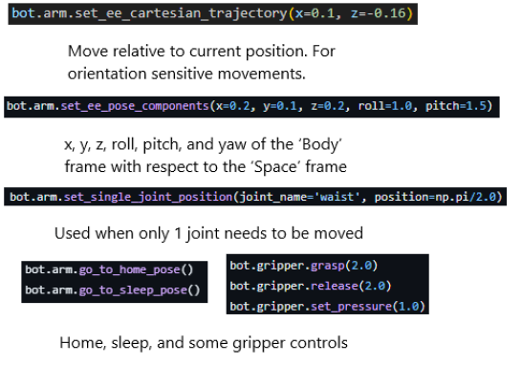
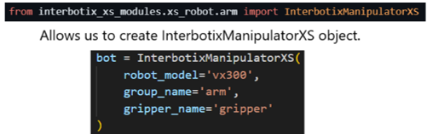
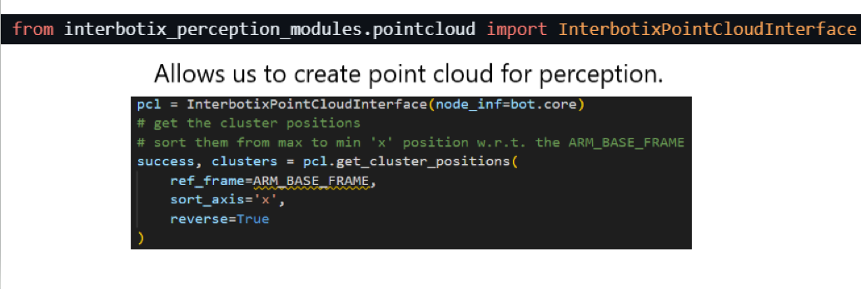
xsarm_control module
Some commands to create a fixed place model with python:

Slide 5
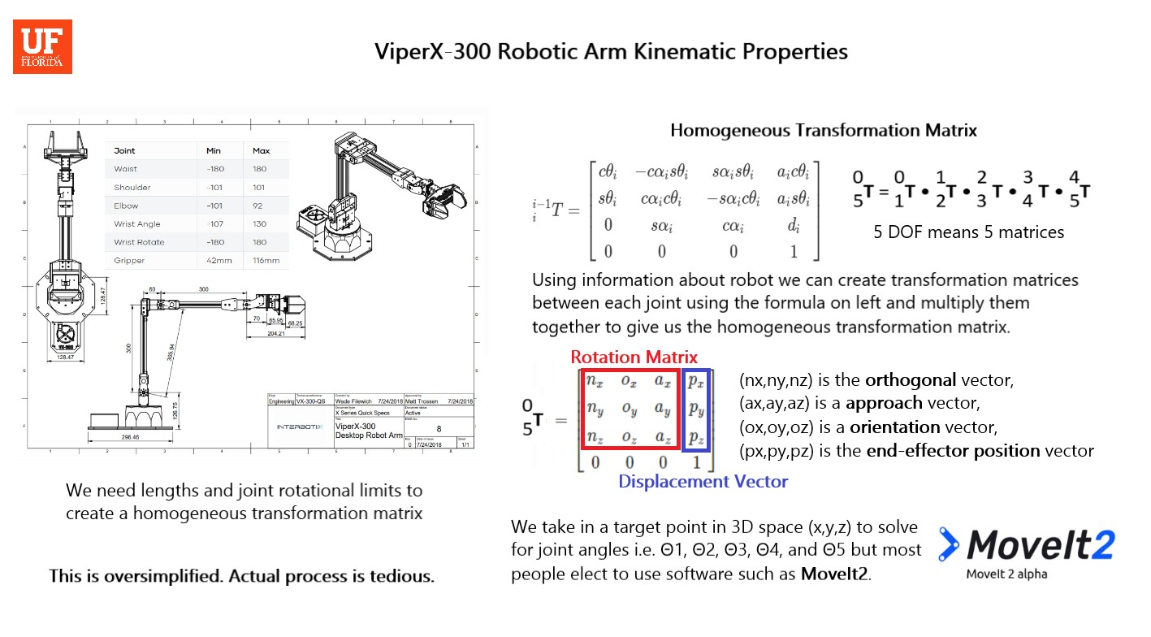

Slide 6
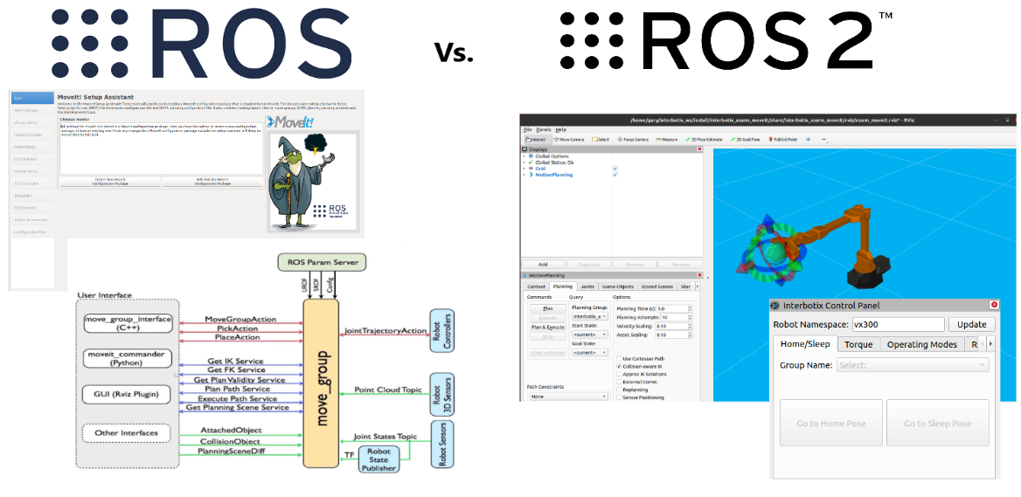



Slide 7
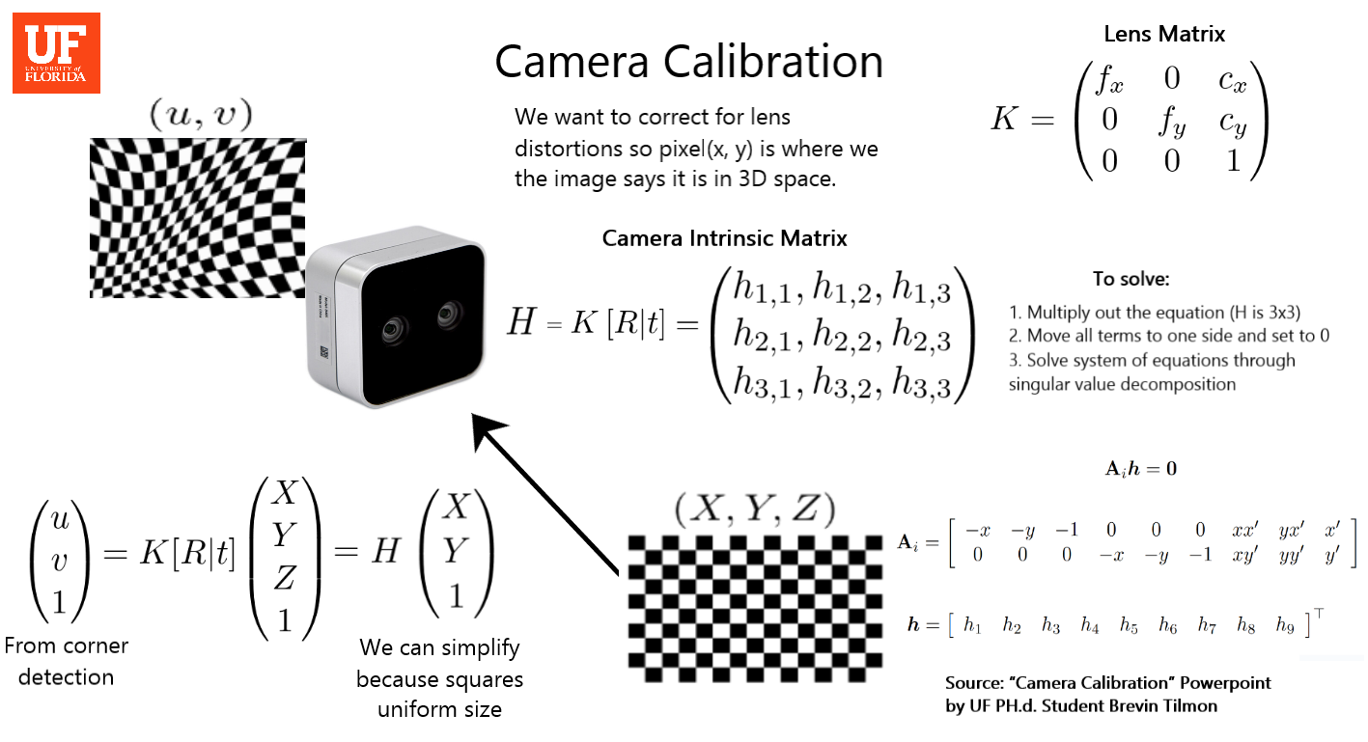

Slide 8
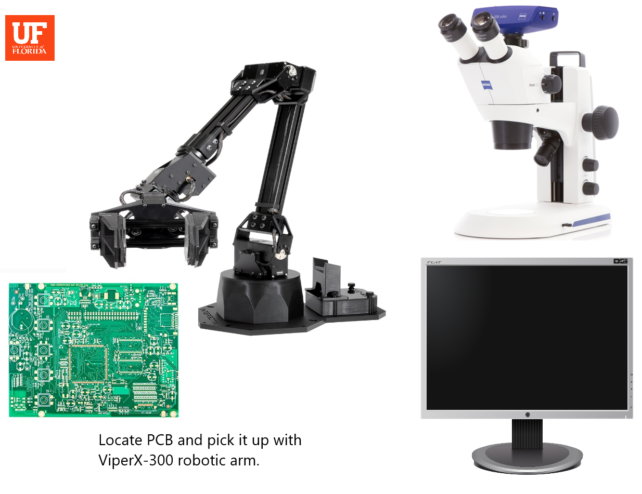
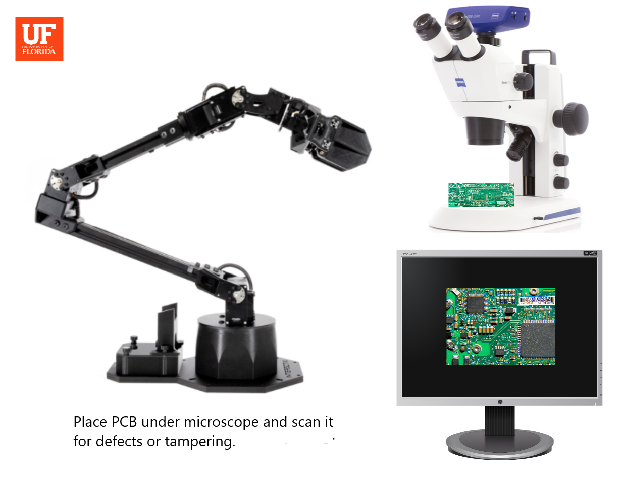
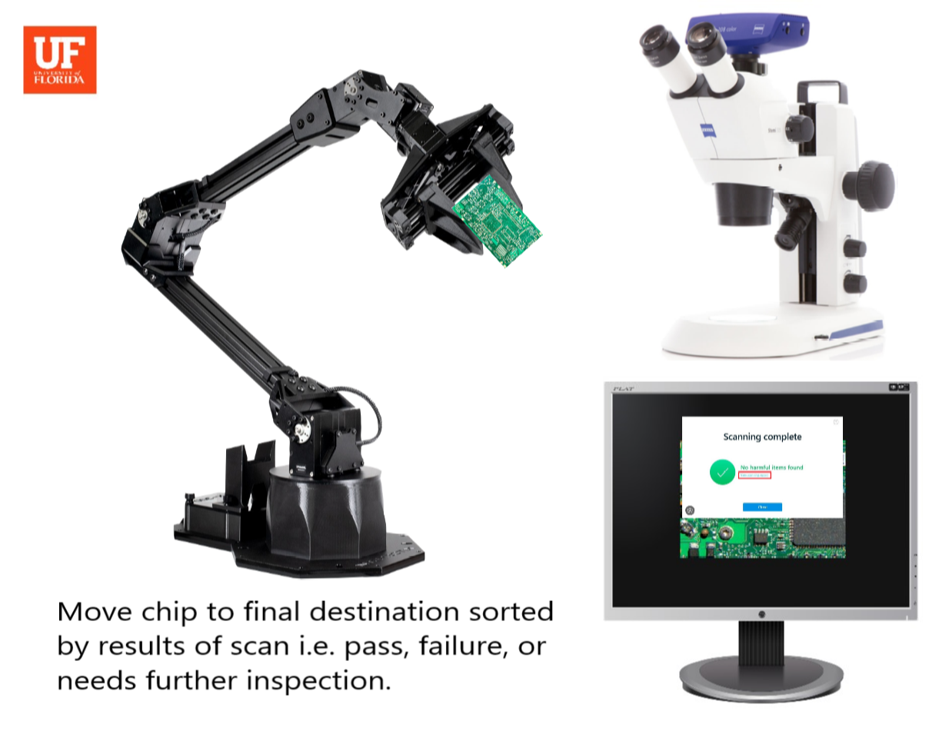
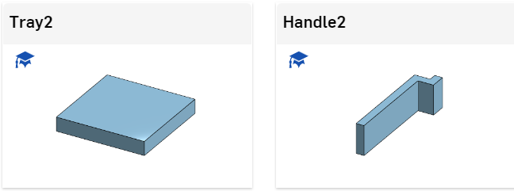
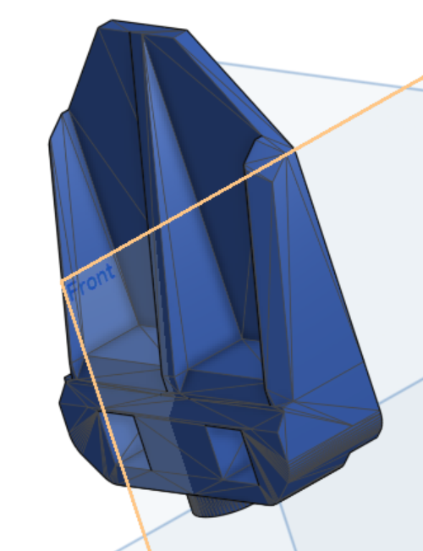
Scanning Process

Slide 9

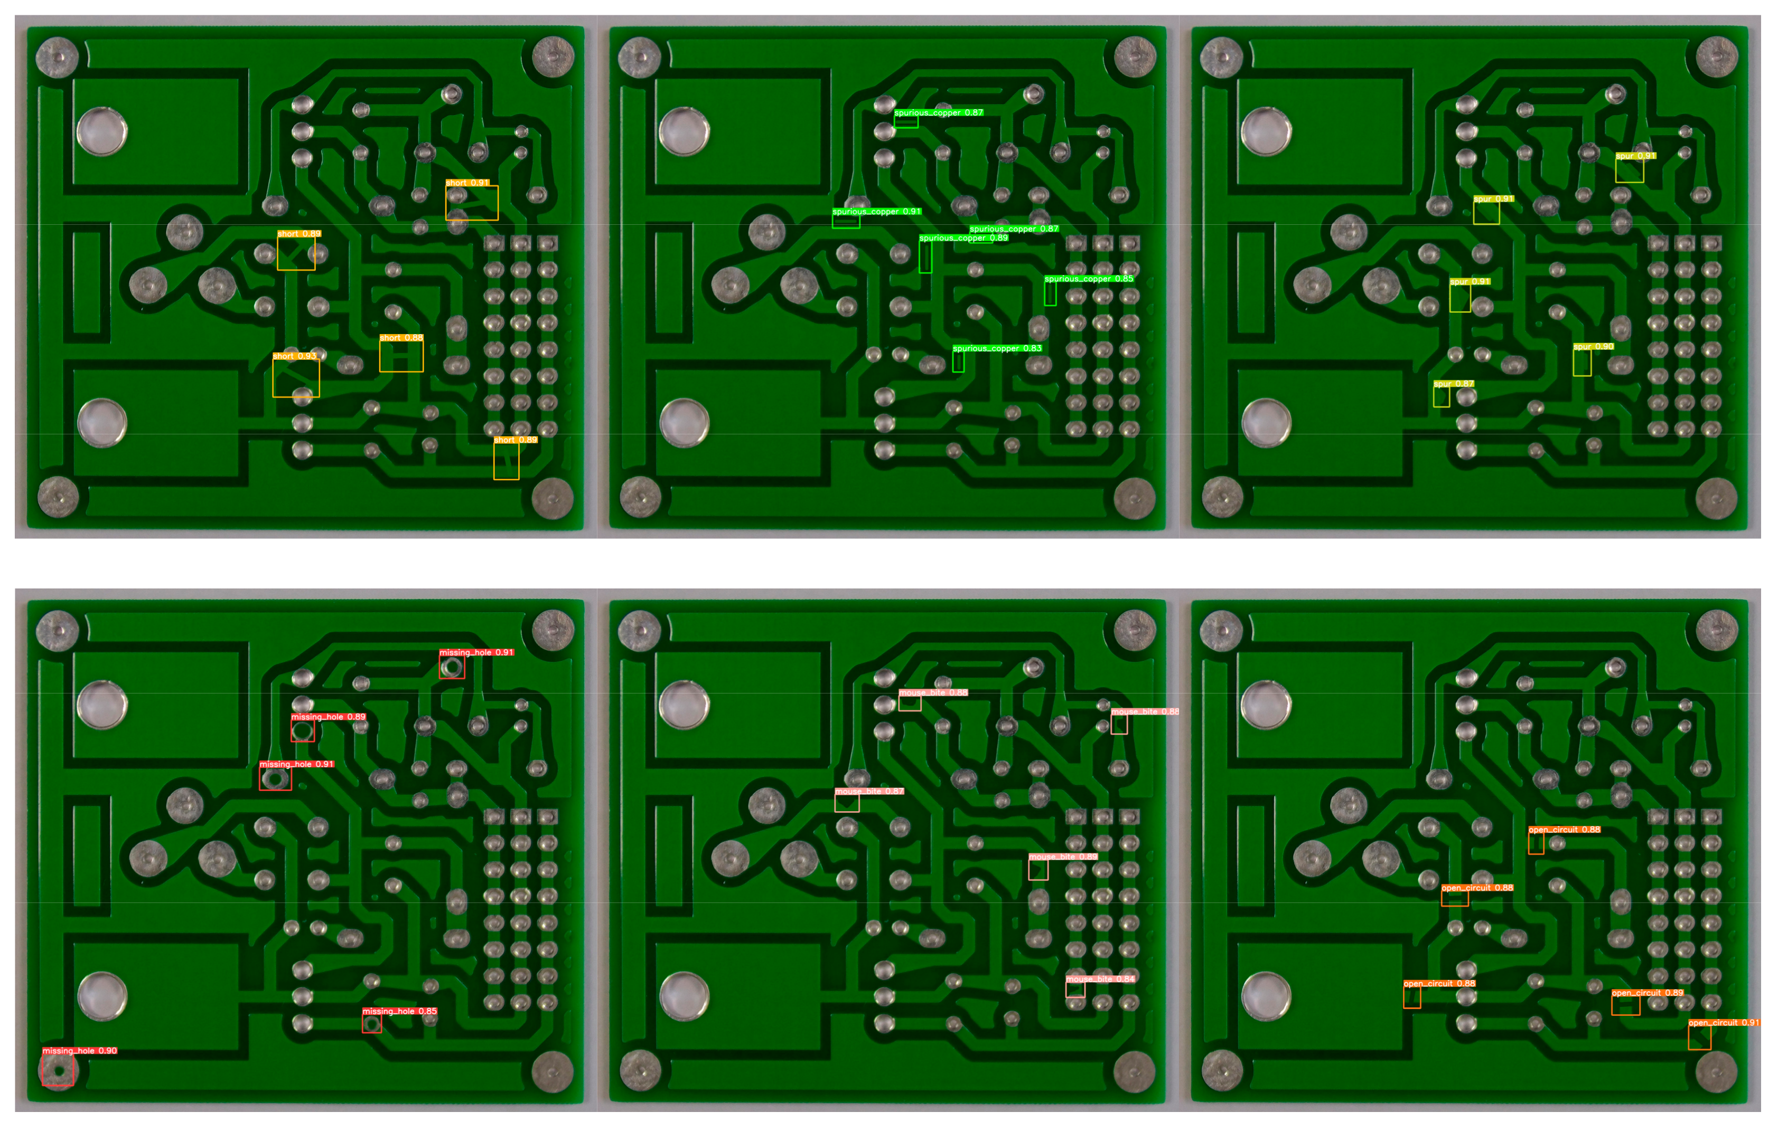
YOLOv5 “You only look once”
Divides image into a grid and predicts what class each grid cell belongs to
Trained with around 600 images of the same PCB in a dataset that was labeled already
Not accurate at all on our test PCBs but it could be one day

